Slide 1


Personalized food warning system
Project Cycle & Code Review
Dongwoo Shin

Slide 2
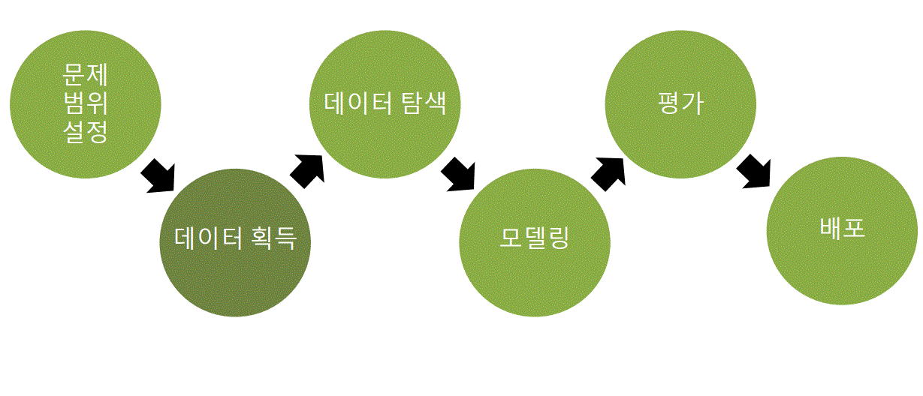
Project Cycle
Set problem scope
Data Navigation
Test
Modeling
Deployment
Data Acquisition

Slide 3
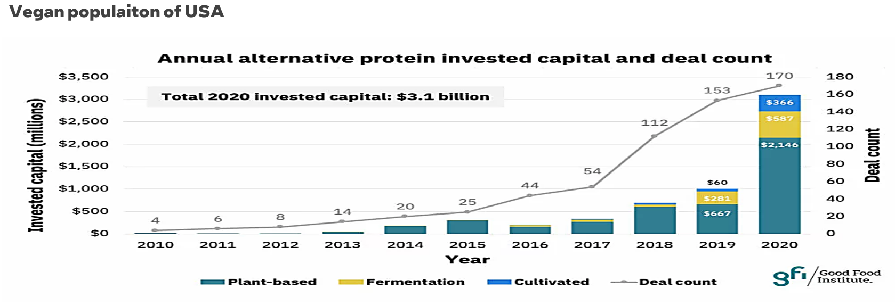
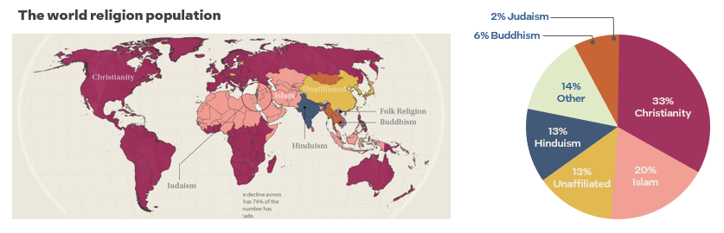
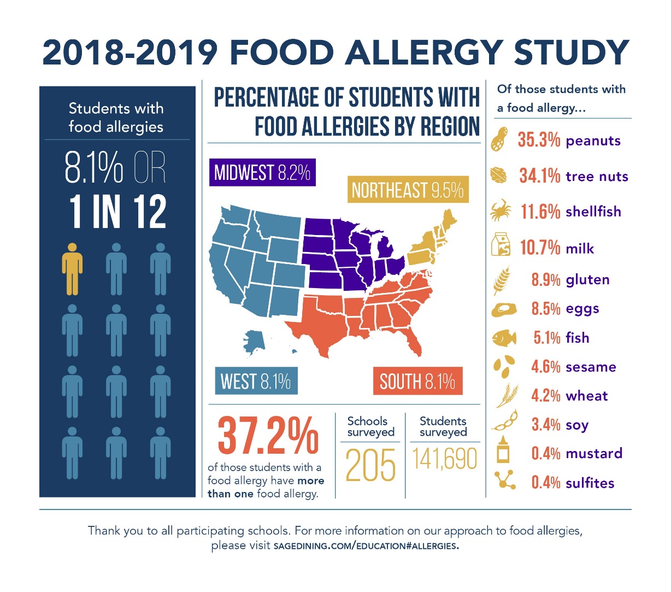
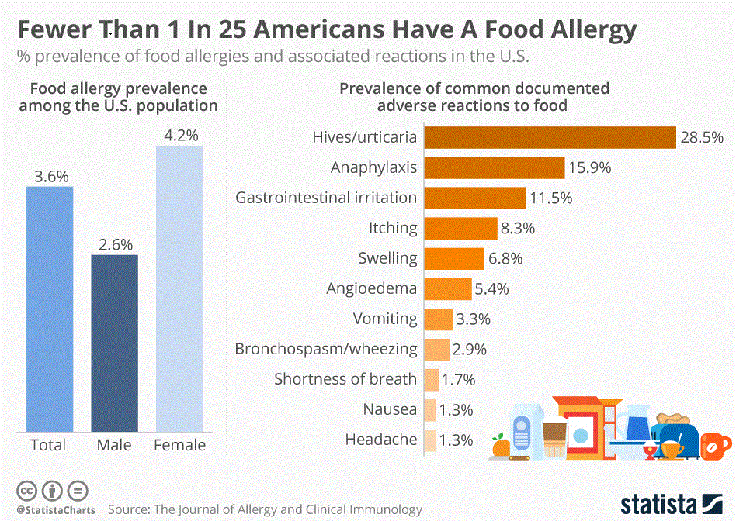
1. Set problem scope

Slide 4




1. Set problem scope( The differentiation of technology)
1. It is not to analyze the nutritional content of simple food.
2. Artificial intelligence analyzes the health(Religion, allergies, vegans, etc) information data entered by the user and analyzes the food that the user should avoid.
3. It is a system that gives warning notifications.
4. It is possible to provide an optimal service that is differentiated for each user.
5. We can respect racial diversity and improve health care.

Slide 5
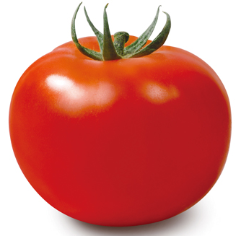
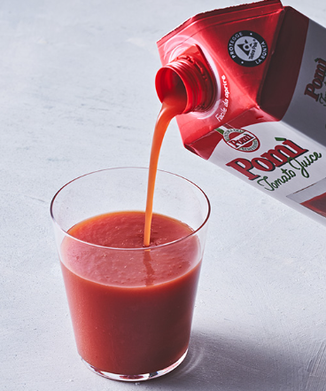
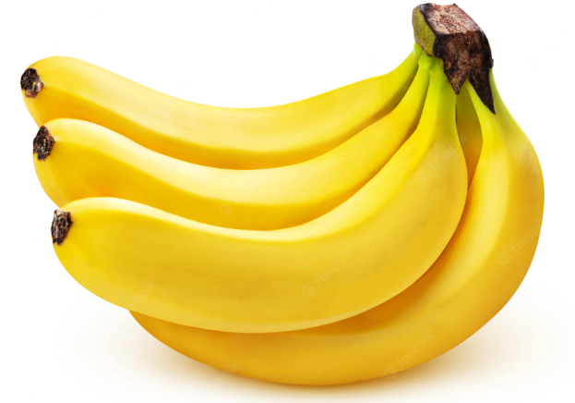
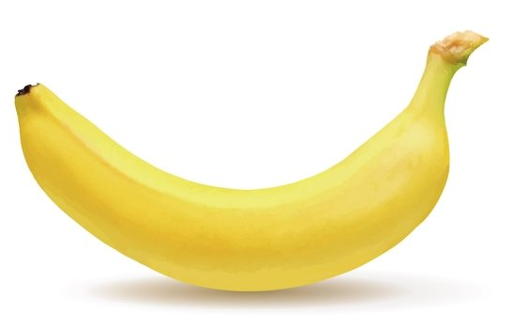
2. Data Acquisition 3. Data Navigation
What’s tomato?
What’s banana?

Slide 6
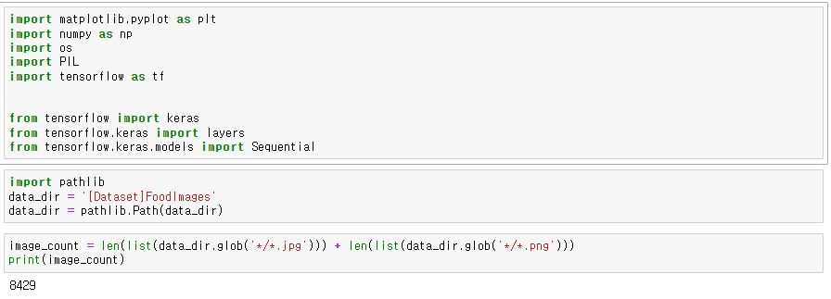
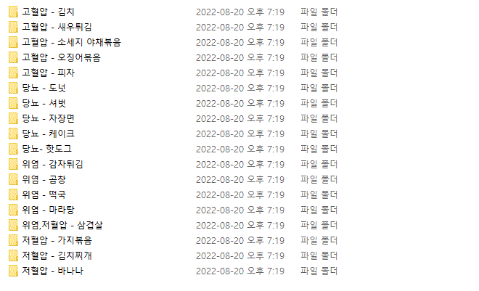
2. Data Acquisition
3. Data Navigation
- Tensorflow keras(framework) : Using the Keras of TensorFlow for basic image classification.
- Sequential : Decided to use the sequential model of Keras to learn.

Slide 7
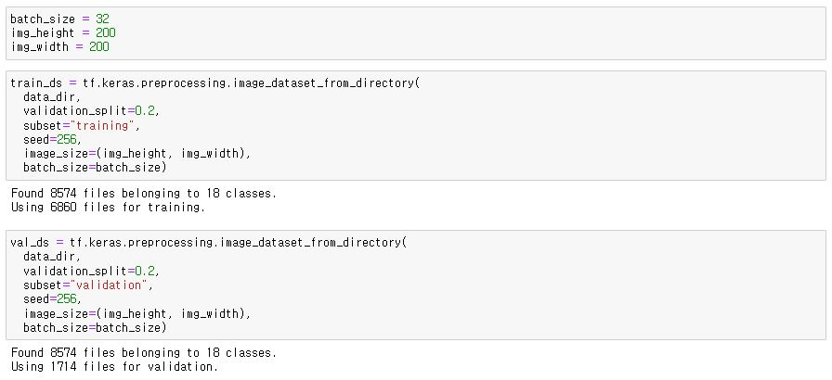
Labeling and purifying collected data
- batch_size : Considering noise and regularization, set a compliant batch size.
- train_ds // val_ds : The process of dividing train data and validation data (image_count)

Slide 8
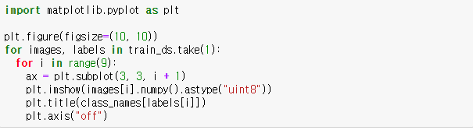
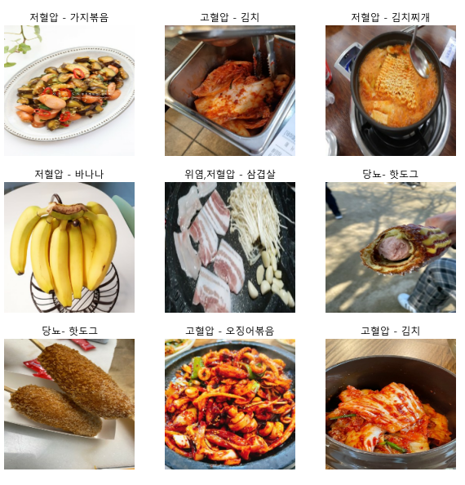
Recall labeled data using a matplotlib
- matplotlib : Outputs the data set correctly using the Matlab library.
Explanation : Indicate and label what complications each food causes..

Slide 9
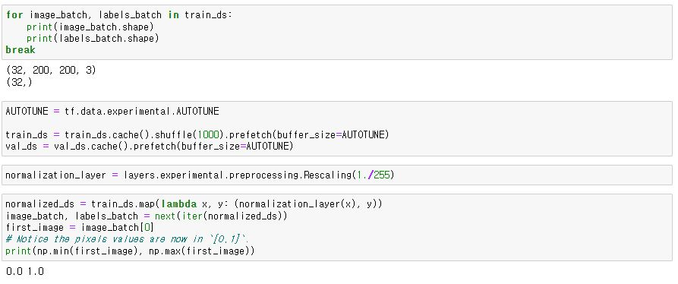
Data preprocessing
- AUTOTUNE : Using AUTOTUNE to reduce working time by mapping hardware resources in parallel.
- Prefetch : Pipeline used to reduce data processing (task) time on GPU.
Explanation : Set batch size, standardize data, and preprocess data (improve speed)..

Slide 10
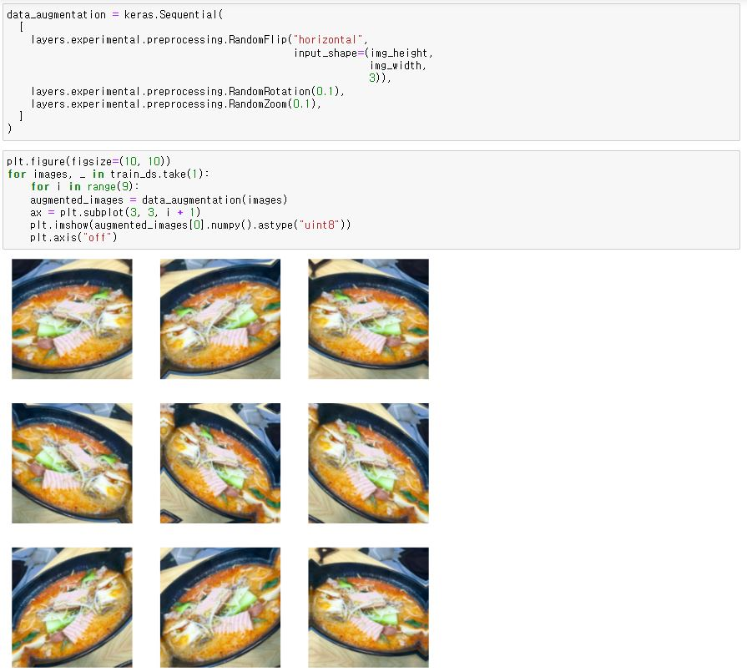
Data augmentation techniques
- Explanation
Determined that the number of data is too small to cause problems with accuracy and loss rate.
I expanded the learning data and trained it again.
Extends learning data by adjusting multiple angles of the image

Slide 11
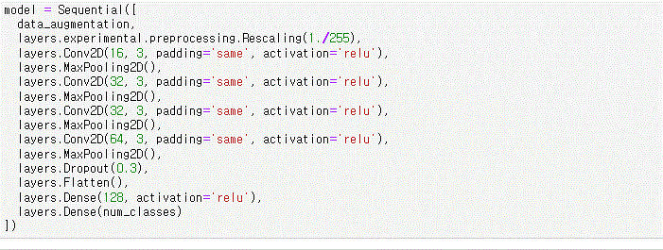
4. Modeling(Model the data.)
Model Using Sequential Models.
Reasons for using the Sequential Model: It's a one-step, sequential neural network model, and it's very simple
Conv2D(activation=‘relu’)
Set the activation function to relu to prevent gradient varishing problems in the convolution layer
Dense(activation=‘relu’)
Set the activation function to relu to reduce the slope problem through backpropagation and produce good performance.
Explanation
The sequential model of keras was used as the model. To increase the accuracy of image classification, we created a model alternating the convolutional (Conv2D) layer and Maxpooling2D to reduce the size of the image at each layer, thus reducing the computation and preventing overfitting.

Slide 12
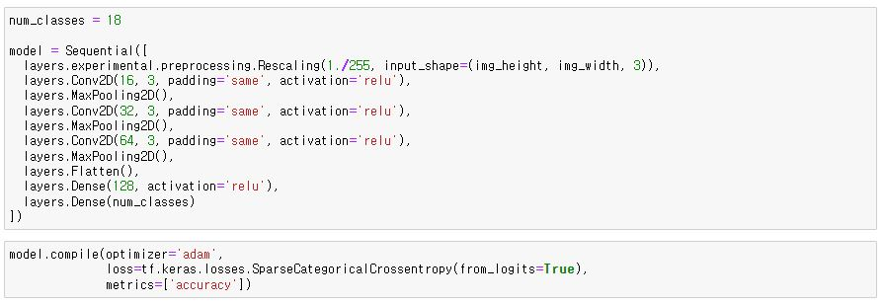
Compile the modeled data
Why Optimizer Adam?
Adam is considered appropriate because it requires a lot of data to perform efficient operations and reduce memory requirements through a simple implementation
- Explanation
The model was previously constructed, and before learning the model, the complex function was used to make various settings necessary for the learning process.
1. The optimizer uses adam to set the optimization method in the learning process in the compilation function. 2. Set for calculating loss rate in loss facility. 3. It was set up to monitor learning with metircs.

Slide 13
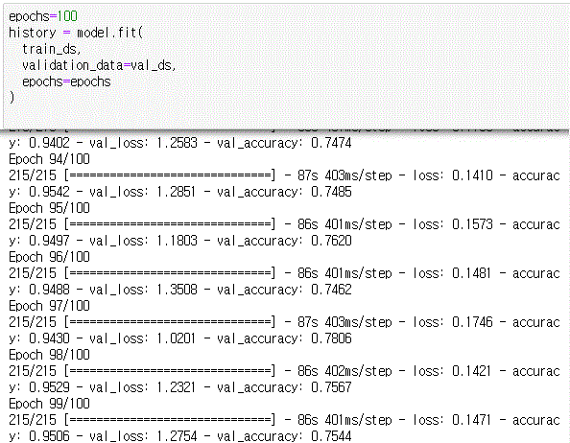
model learning
- Explanation
Use the Fit function to learn the model. 1. The first factor is the training data set (80%) 2. The second factor is val_ds (20%) i.e., data labeled in the train process. 3. The third factor designated the number of studies as 100.

Slide 14
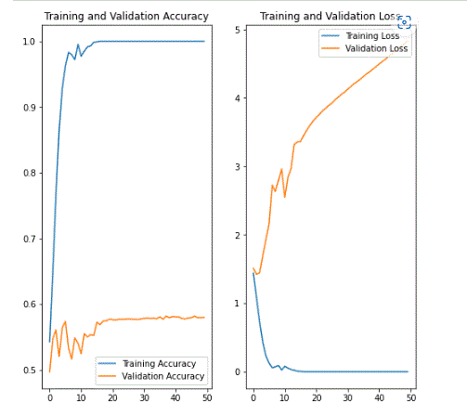
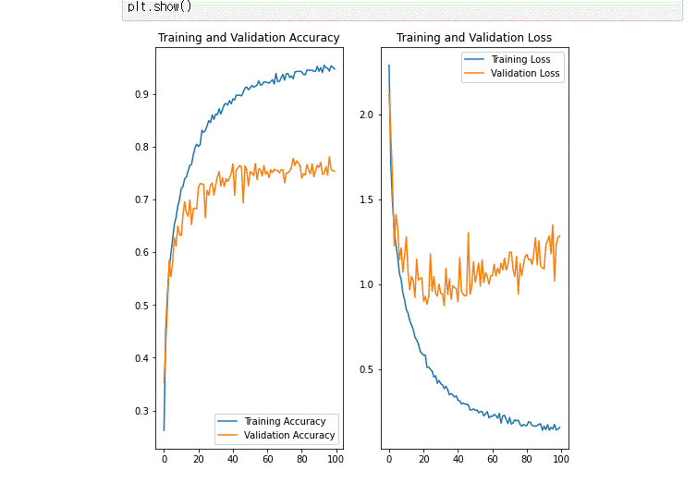
- Explanation
- Explanation
Results of the first training graph Problem: somewhat low accuracy, somewhat high loss rate
Accuracy is getting higher than before. The loss rate is also much lower than before.

Slide 15
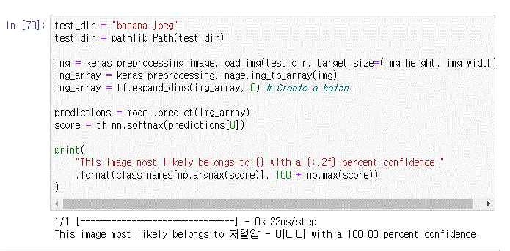
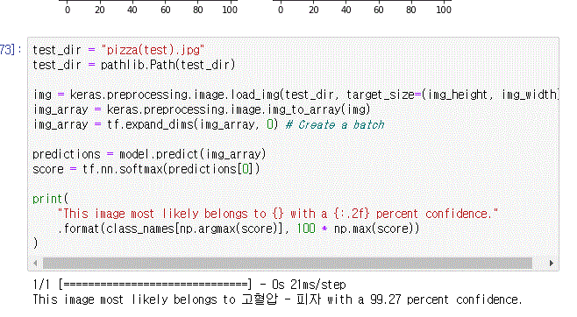
4. Test
- Explanation
When I entered a picture of banana that was not included in the training data into the model, it was 100% accurate because it was banana.
* Currently, a prototype has been created to accurately distinguish food *

Slide 16

Personalized food warning system
THANKS!

